Slide 1


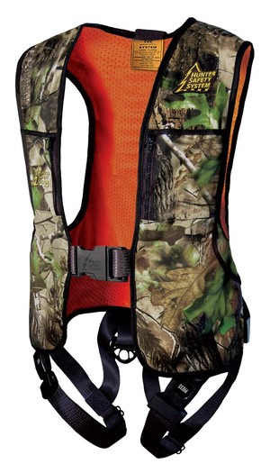

CAMP BLANDING ROD & GUN CLUB
NEW MEMBER SAFETY BRIEFING AND ORIENTATION

Slide 2
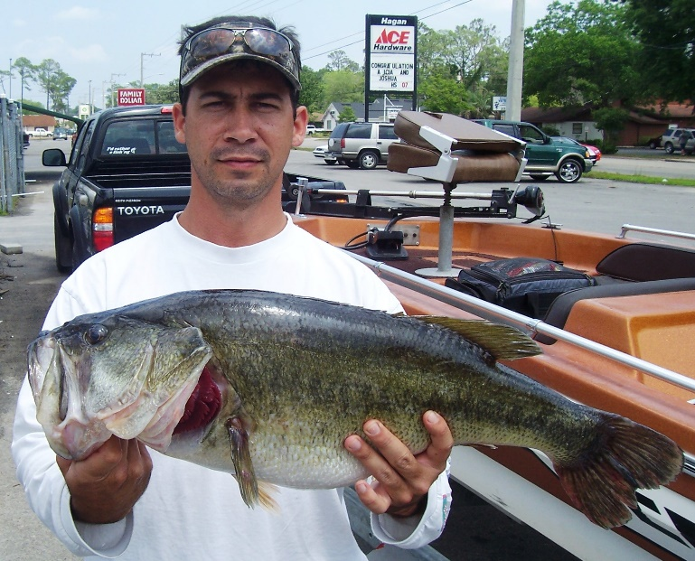
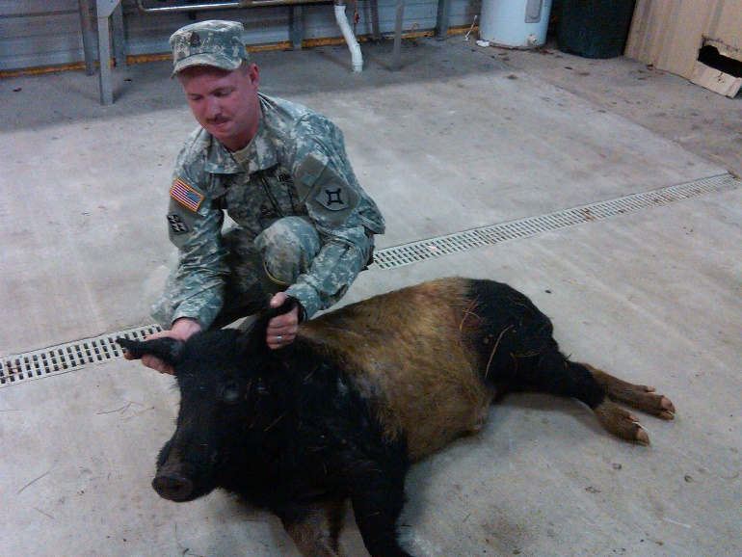
CAMP BLANDING ROD & GUN CLUB
The Installation Commander demands Safety First, and so do we.
Our Club is a recreational benefit for active and retired members of the Florida Army and Air National Guard and employees of the Department of Military Affairs.
Our Special Events financially support the Wounded Warrior Project, Florida Youth Challenge Academy and the Florida National Guard Foundation. Members are requested to support these events.
We offer a variety of outdoor recreation possibilities including access to hunting and fishing areas unavailable to the general public.
Access to hunting and fishing are subject to closure at any time for military training. Members must check status before entering any area.

Slide 3
CAMP BLANDING ROD & GUN CLUB
HUNTING: Over 7800 acres are available for Deer, Hog, Turkey and small game hunting during Archery, Crossbow, Muzzle loading, and General Gun seasons. Range operations and troop training take priority over R&G activities. Some activities / areas may not be available.
FISHING: In addition to Kingsley, Lowery and Magnolia Lakes, other lakes and small ponds have been set aside exclusively for members. Largemouth bass, Shell cracker, Perch and Bream abound.

Slide 4
CAMP BLANDING ROD & GUN CLUB
HUNTER’S CODE OF ETHICS
I will consider myself an invited guest of Camp Blanding and conduct myself in a manner that positively promotes the Club.
I will always handle my weapons in a safe manner and insist that others who hunt with me do the same.
I will obey all FWC game laws and regulations, and will ensure my companions do likewise.
I will hone my marksmanship and hunting skills to insure clean, sportsmanlike kills.
I will support conservation efforts, which can assure good hunting for the future generations of Americans.
I will pass along to younger hunters the attitudes and skills essential to a true outdoor sportsman.
I will extend dignity and respect to others and expect the same from them in return.

Slide 5
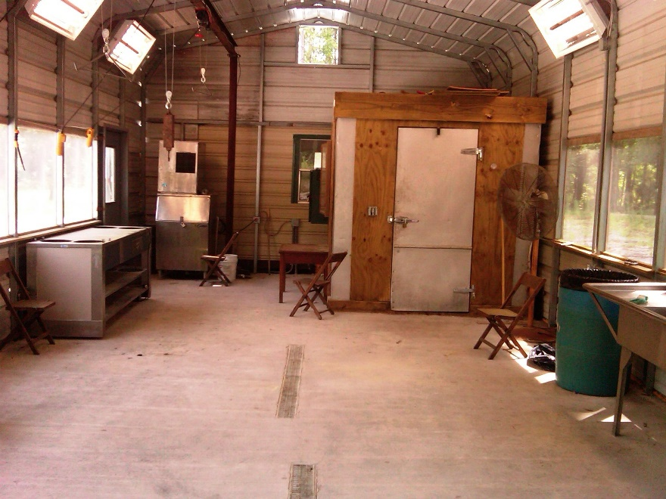
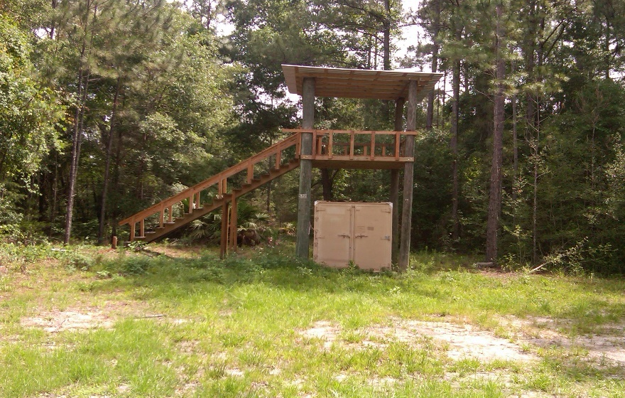
CAMP BLANDING ROD & GUN CLUB
Clubhouse
Located on Ave D (bldg 5620) it’s furnished with electricity, water, skinning racks, ice machine, walk-in cooler and Archery tower.
The combination to the Clubhouse, and approved gates will be provided in your welcome packets.
Combinations are changed at least once a year for security reasons.

Slide 6
CAMP BLANDING ROD & GUN CLUB
Elected Board of Directors enforce the Club Rules, By-Laws, Safety and Installation Policies and Procedures and coordinate activities with the Installation Commander. Board member POC information is posted on the website.
Members are not authorized to contact CBJTC leadership or Range Control directly. All issues must be directed to the Board.
Rules, By-Laws, MOA, Maps and all administrative forms are available on our website: www.campblandingrod-gunclub.com

Slide 7

CAMP BLANDING ROD & GUN CLUB
READ and understand the MOA, Club Rules and By-laws.
Members are subject to disciplinary actions ranging from fines to dismissal if found guilty of violating Club Rules, By-laws, or Installation Policies.

Slide 8
CAMP BLANDING ROD & GUN CLUB
Hunting and Fishing is based on Florida Wildlife Commission (FWC) annual regulations.
Camp Blanding Safety, Range Control and Military Police Policies must be observed at all times.

Slide 9
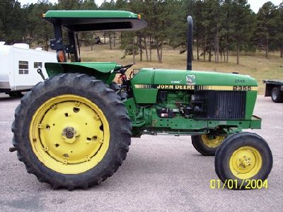
CAMP BLANDING ROD & GUN CLUB
Club meetings are scheduled the 1st Tuesday nights in April and September with several work days scheduled throughout the year. The Event Calendar is posted on the website.
Members are required to attend at least 2 events per season, 01 Jul – 30 Jun, as an active member or pay a $50 fine.
Club tractor and attachments are available to all members but operated by approved Tractor Committee.

Slide 10
CAMP BLANDING ROD & GUN CLUB
Each hunting area has restrictions on what type of weapon is authorized, specified in the MOA.
Never violate a Range Control cables or range flags.
Hang one Club ID card in the Clubhouse to identify the area you are hunting (optional, mandatory for club stands) and keep the other in your possession.
Possession of alcohol on R&G hunting areas is PROHIBITED.
Police all trash wherever found.

Slide 11
CAMP BLANDING ROD & GUN CLUB
Guests must be signed in and pay daily fees by the end of the hunting / fishing day.
Always call the Hotline (904) 682-3318 when planning your hunting or fishing trip.
Do not enter any area that’s closed.
Always have your CBJTC Medical Evacuation Information card in your possession. (on website)
Vehicles entering approved Club areas must have a valid CBR&GC decal.

Slide 12
CAMP BLANDING ROD & GUN CLUB
Stay tuned to the club website @ www.campblandingrod-gunclub.com
The website is user friendly including the phone numbers and e-mail addresses of board members to answer your questions.
All correspondence from the Board to the membership is via e-mail and website postings.

